Slide 1
Challenges and Variations
--Sri Harsha, CyberEye.

Slide 2
Other challenges
Taint through operations
tainted a, untainted b, c=a+b-- is c tainted? (yes, probably)
Function [pointers
What function can this call go to?
Can flow analysis to compute possible targets
Struct fields
Track the taintedness of the whole struct, or each field?
Taintedness for each struct instance, or shared among all of them (or something in between)?
Arrays
Keep track of taintedness of each array element, or one element representing the whole array?

Slide 3
Refining taint analysis
Can label additional sources and sinks
Array bounds accesses: must have untainted index
Can expand taint analysis to handle sanitizers
Functions to convert tainted data to untainted data
Other application: Leaking confidential data
Don’t want secret sources to go to public sinks
Implicit flows more relevant in this setting
Dual of tainting

Slide 4
Other kinds of analysis
Pointer Analysis (“points-to” analysis)
Determine whether pointers point to the same locations
Shares many elements of flow analysis. Really advanced in the last 10 years.
Data Flow Analysis
Invented in the early 1970’s. Flow sensitive, tracks “data flow facts” about variables in the program
Abstract interpretation
Invented in the late 1970’s as a theoretical foundation for data flow analysis, and static analysis generally.
Associated with certain analysis algorithms

Slide 5
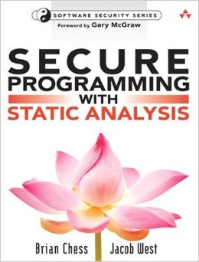
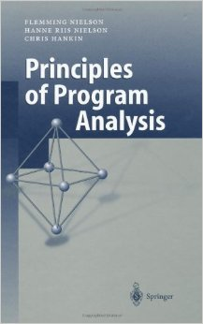
More References:-
Secure Programming with Static Analysis, by Brian Chess, goes into more depth about how static analysis tools work, and can aid secure software development
Principles of Program Analysis, by Nielson, Nielson, and Hankin, is a formal, mathematical presentation of different analysis methods
A bit dense for the casual reader, but good for introducing the academic field

